Slide 1
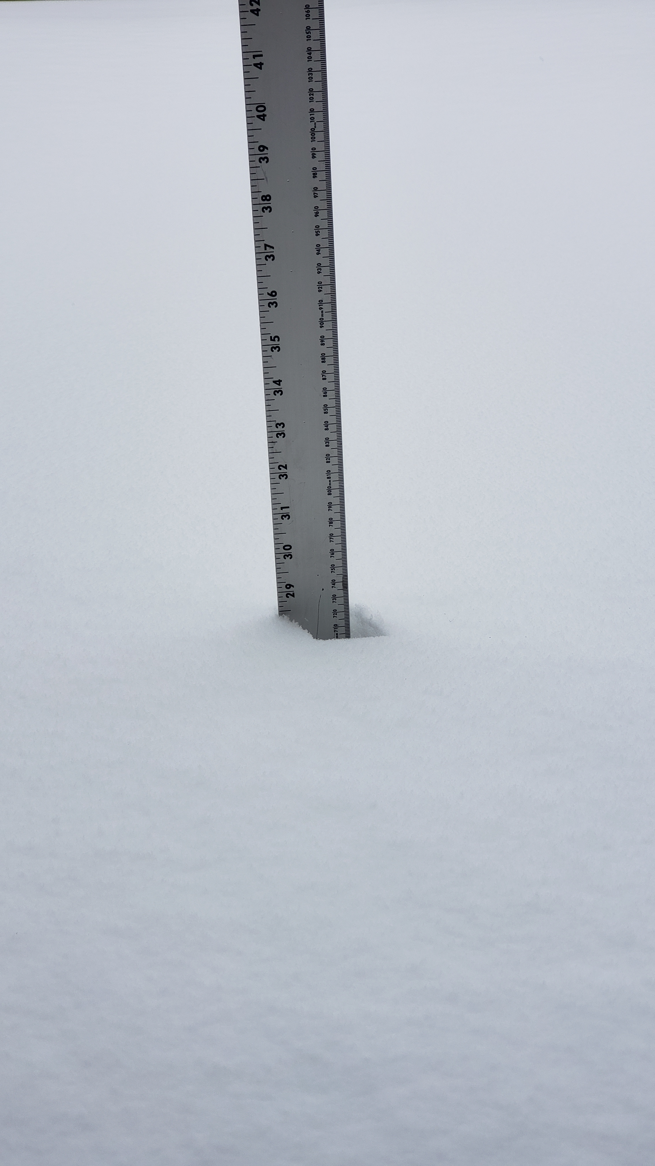
Fall 2022
Bottom-Up Design

Slide 2
CSE 130 – Algorithm Design Loops Class 19
Winter 2023
Brother Godderidge

Slide 3
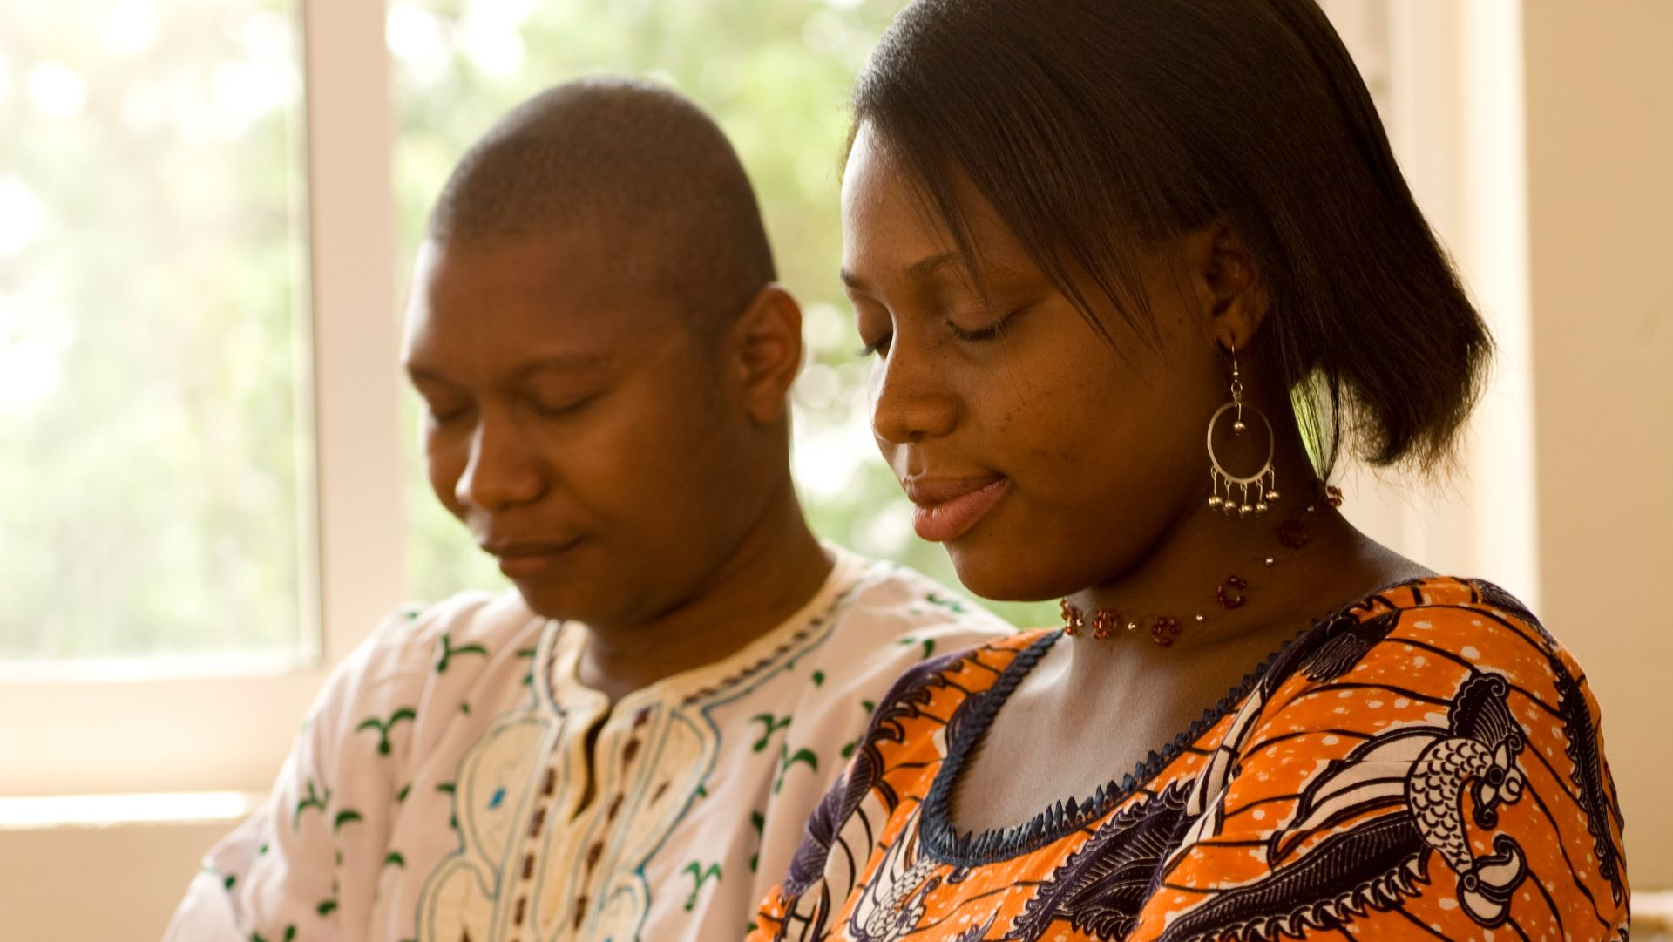
Opening Prayer

Slide 4
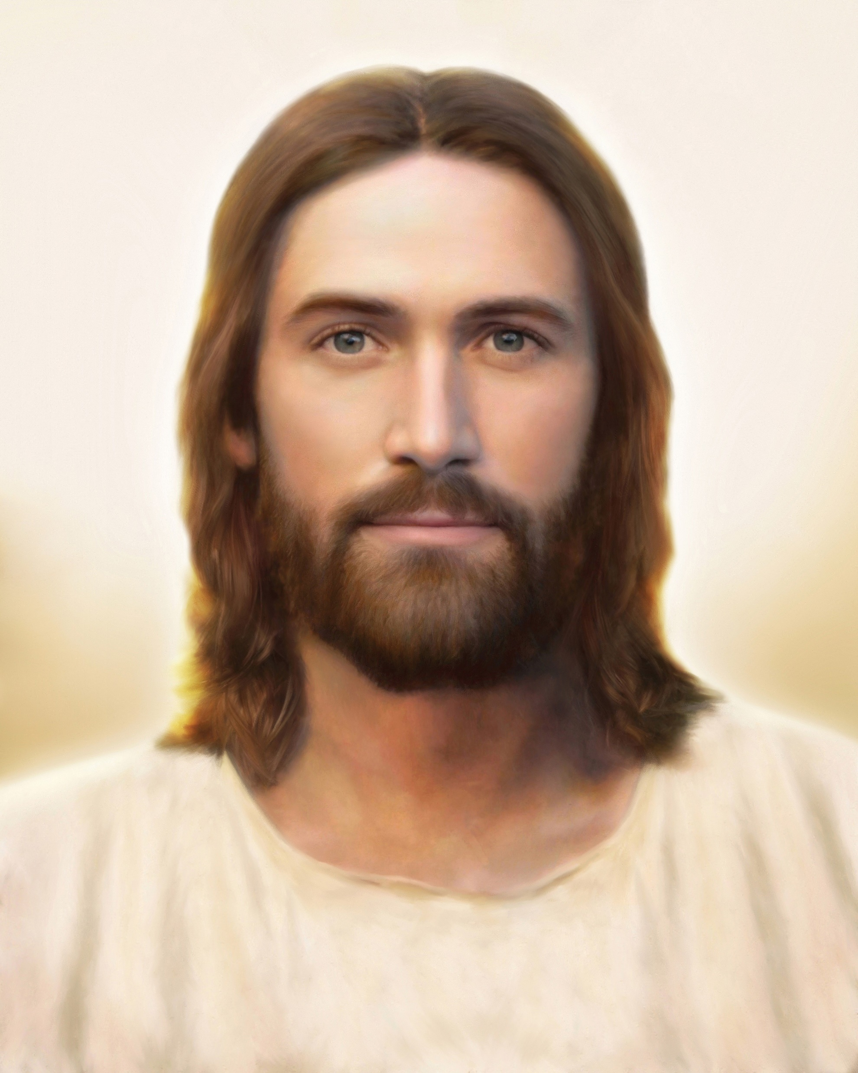
Spiritual Thought
2nd Nephi 25
20 And now, my brethren, I have spoken plainly that ye cannot err. And as the Lord God liveth that ªbrought Israel up out of the land of Egypt, and gave unto Moses power that he should ^{b}heal the nations after they had been bitten by the poisonous serpents, if they would cast their eyes unto the ^{c}serpent which he did raise up before them, and also gave him power that he should smite the ^{d}rock and the water should come forth; yea, behold I say unto you, that as these things are ^{e}true, and as the Lord God liveth, there is none other ^{f}name given under heaven save it be this Jesus Christ, of which I have spoken, whereby man can be saved.
Notes:
How does us coming unto Jesus help us? Help others?

Slide 5
Spiritual Thought
2nd Nephi 25
23 For we labor diligently to write, to ªpersuade our children, and also our brethren, to believe in Christ, and to be reconciled to God; for we know that it is by ^{b}grace that we are saved, after all we can ^{c}do.
Notes:
How does us coming unto Jesus help us? Help others?

Slide 6
Spiritual Thought
2nd Nephi 25
26 And we ªtalk of Christ, we rejoice in Christ, we preach of Christ, we ^{b}prophesy of Christ, and we write according to our prophecies, that our ^{c}children may know to what source they may look for a ^{d}remission of their sins.
Notes:
How does us coming unto Jesus help us? Help others?

Slide 7
Spiritual Thought
2nd Nephi 25
29 And now behold, I say unto you that the right way is to believe in Christ, and deny him not; and Christ is the Holy One of Israel; wherefore ye must bow down before him, and ªworship him with all your ^{b}might, mind, and strength, and your whole soul; and if ye do this ye shall in nowise be cast out.
Notes:
How does us coming unto Jesus help us? Help others?

Slide 8
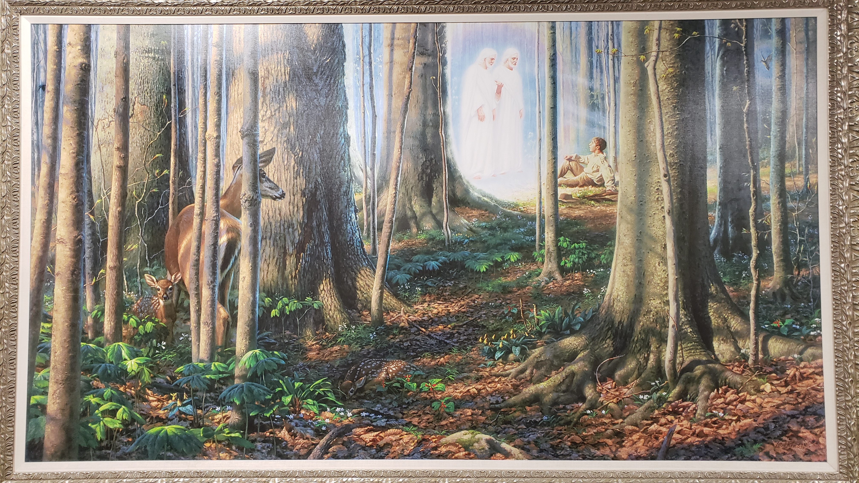
Around Campus

Slide 9
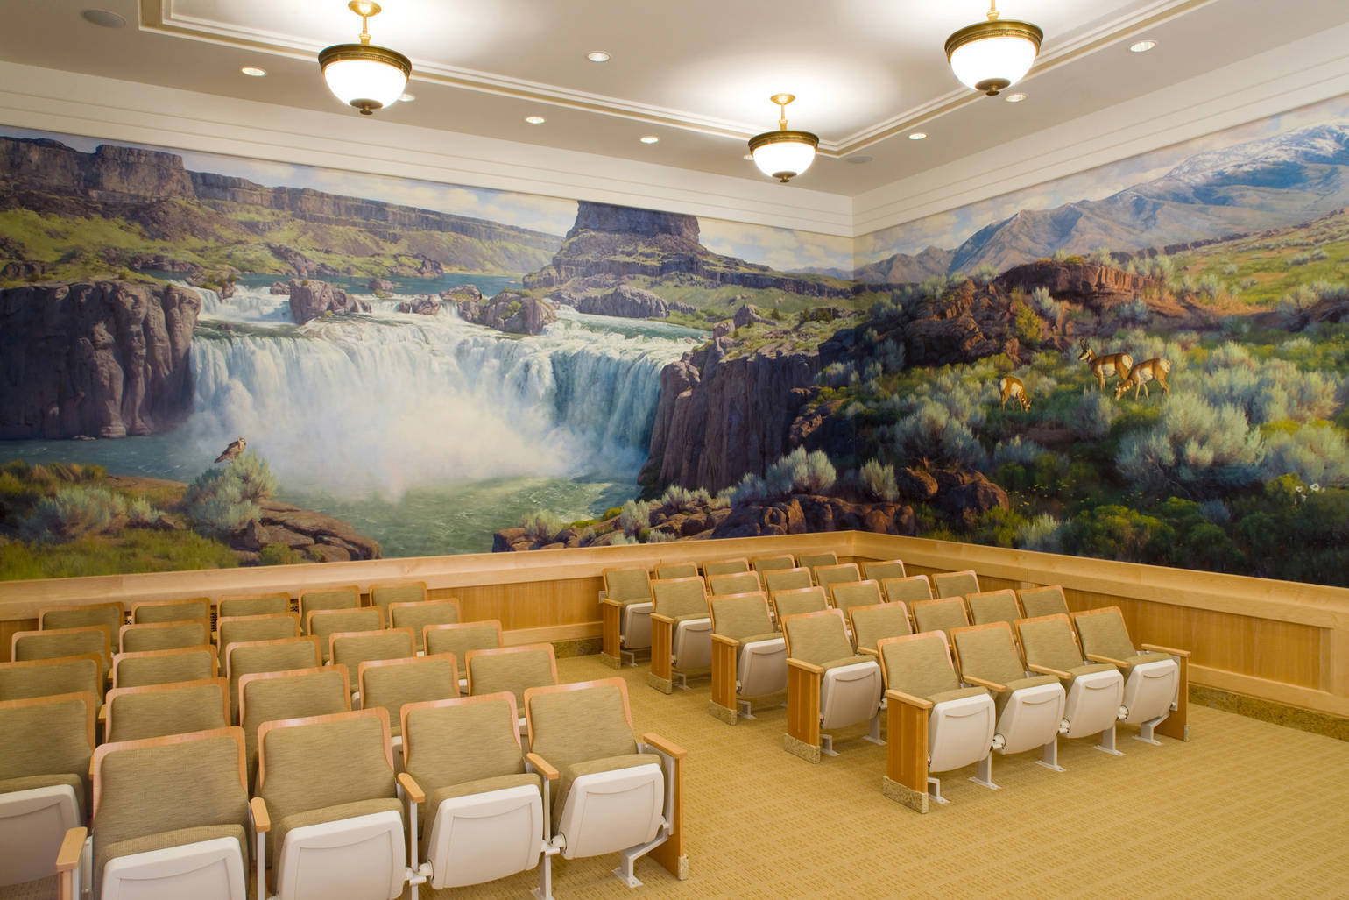

Slide 10
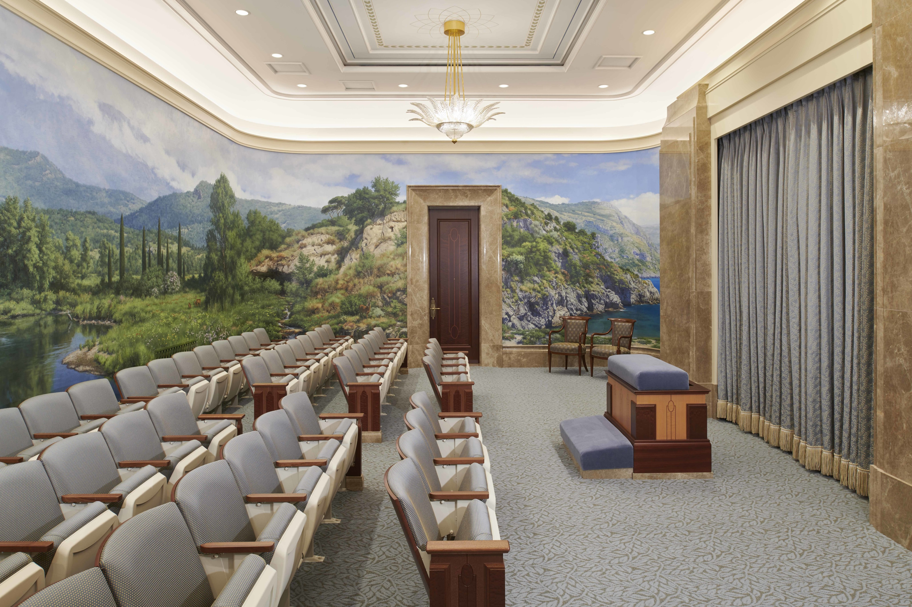

Slide 11
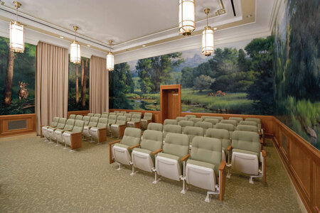

Slide 12
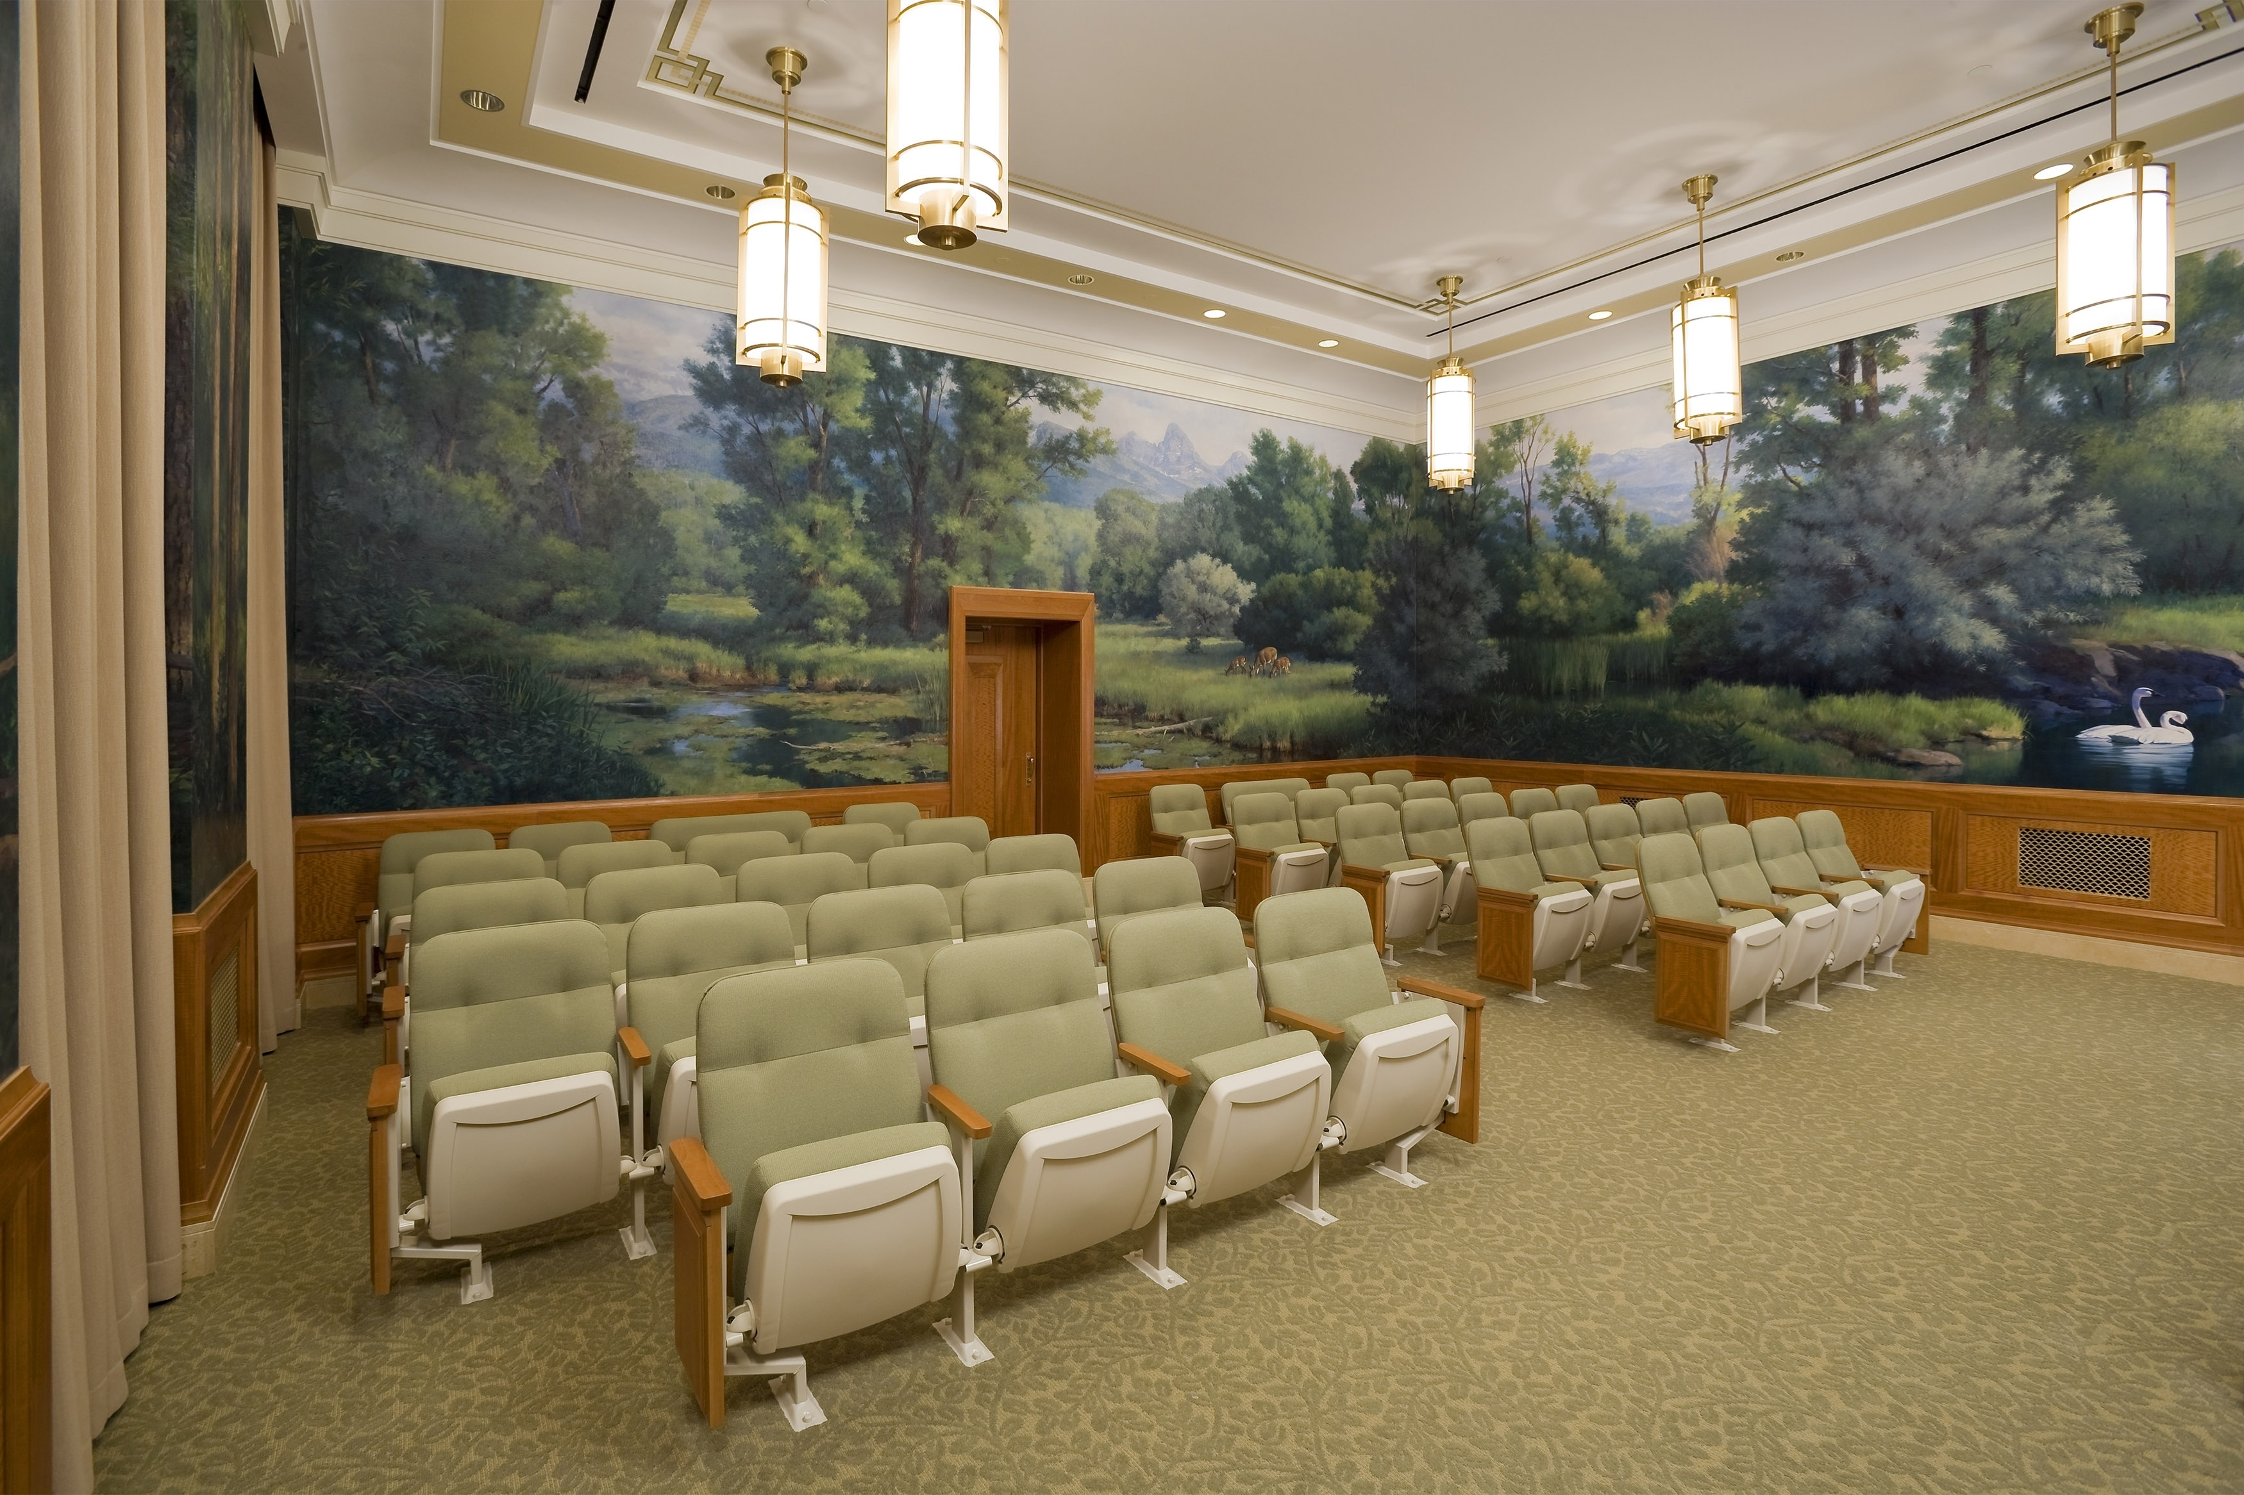

Slide 13
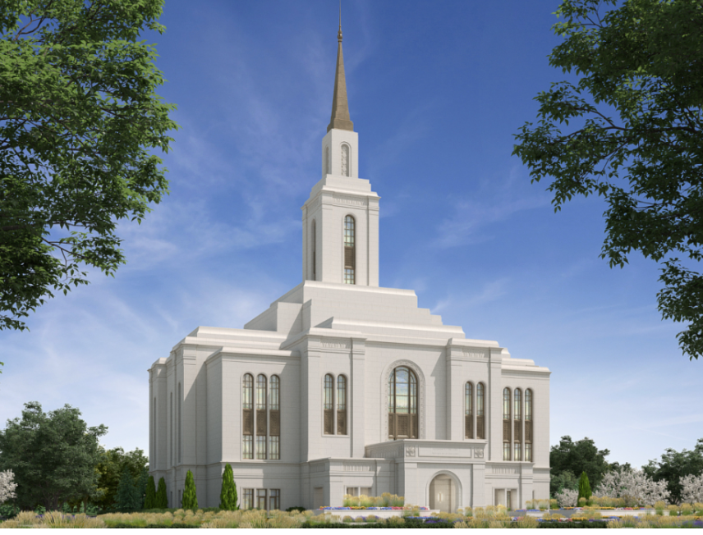
Teton River Temple
Groundbreaking – June 1st

Slide 14
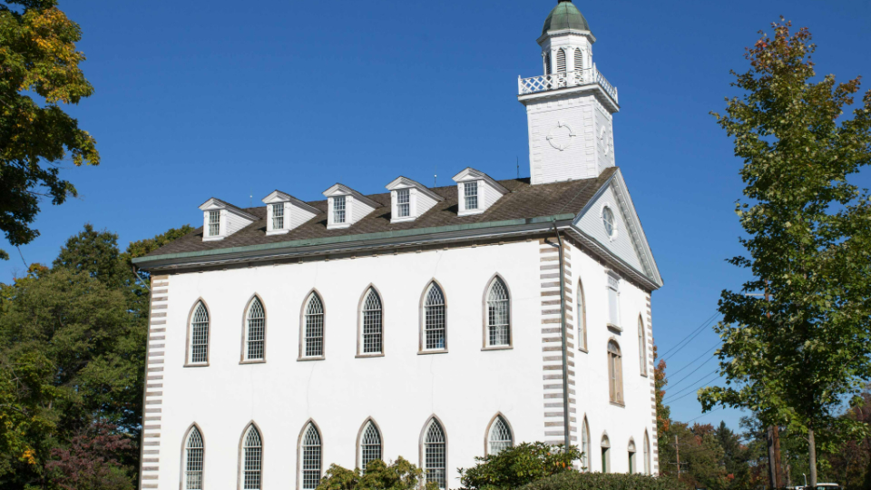
Church now owns Kirtland Temple
Also additional properties in Nauvoo, plus purchased many documents and artifacts
Frequently Asked Questions Clarify the Transfer of Sacred Sites and Historic Do (churchofjesuschrist.org)

Slide 15

Daylight Savings Time
Sunday March 10, 2:00 am
Notes:
The computer will run the instructions one at a time – in order. Line upon line.
As in our previous examples, the computer runs our code in order.
Show another example.

Slide 16
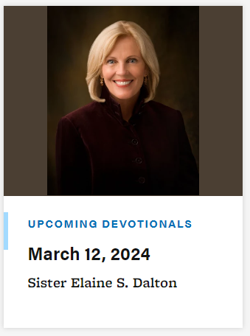
Devotional
Live your life such that when you are in need of a blessing you can approach God in righteousness, rather than mercy, and he will bless you.
The will to win means nothing without the will to prepare
The man with the blue eyes
My covenant is easy

Slide 17
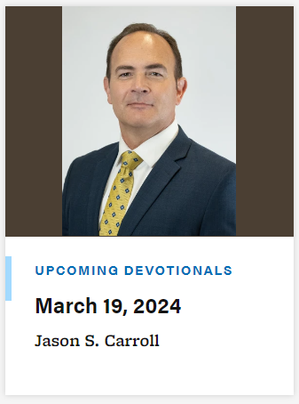
Devotional

Slide 18

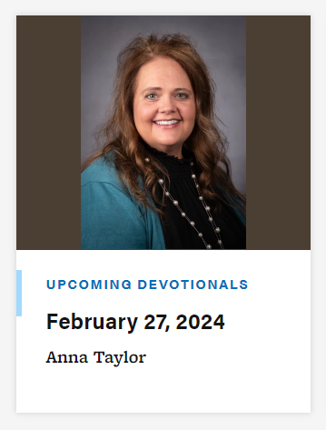
Devotional

Slide 19


Every Tuesday, Thursday, and Friday
3:30 – 6:30 PM

Slide 20

Computing Society - Wed, 5:00 - 5:30 STC398
Teams:
Cloud Solutions - Thursdays, 5:00pm STC 353
Cybersecurity - Tuesdays, 4:30pm STC 295
Coding Interview – Thursdays, 5:00pm STC 385
Data Science/AI - Wednesdays, 5:30pm STC 398
Formula Hybrid+Electric - Tuesdays & Thursdays, 6:00pm AUS 213
Game Development - Thursdays & Fridays, 6:00pm STC 385
IEEE - Tuesdays, 5:30pm STC 243
Operating Systems Development - Wednesdays, 5:30pm STC 361
SWE (Society of Women Engineers) - Wednesdays, 5:30pm STC 341
UAS/Drone - Thursdays, 5:00pm MC 101
Web Design & Development - Wednesdays, 5:30pm STC 221

Slide 21
Announcements
Societies:
Amateur Radio, 1st and 3rd Wednesdays, 6:00-7:00pm, STC 252
Brain Control Technology, Tuesdays 6:30pm, STC

Slide 22
Announcements
Societies:
Upcoming Events:
TBD

Slide 23
Announcements
Academic Peer Mentoring - we have students that want to help you with any questions you may have about your major, what classes to take, how to get an internship, etc. Please reach out to us or Dallin Scott or Preston Coreless for more information.

Slide 24

Announcements

Slide 25
Announcements REU (Research Experience for Undergraduates) Site: Cloud Computing Security & Privacy this year
Hello undergraduate students, The department of Computer Science at Boise State University will be running a summer research program - REU Site: Cloud Computing Security & Privacy this year. When: 5/20/2024 - 7/19/2024 (9 weeks) Where: Department of Computer Science, Boise State University, Boise, Idaho Stipend: $6,300. Meals: $130/week for meals. Housing is provided for non-local students. Round trip flight: Cover up to $700. Application deadline: 3/22/2024 You can access the website of the REU CCSP for more information, or you can apply here. Feel free to reach out, if you have any questions.
Jyh-haw Yeh
Associate Professor
Co-director of MS Cybersecurity
Program Director of GenCyber Teacher Camp
Point of Contact for NACE-C, PoS and DoD CySP at BSU
Computer Science, Boise State University

Slide 26

University Forums

Slide 27
Department Forums
Thursday, April 4th – Dustin Hill from Disney

Slide 28
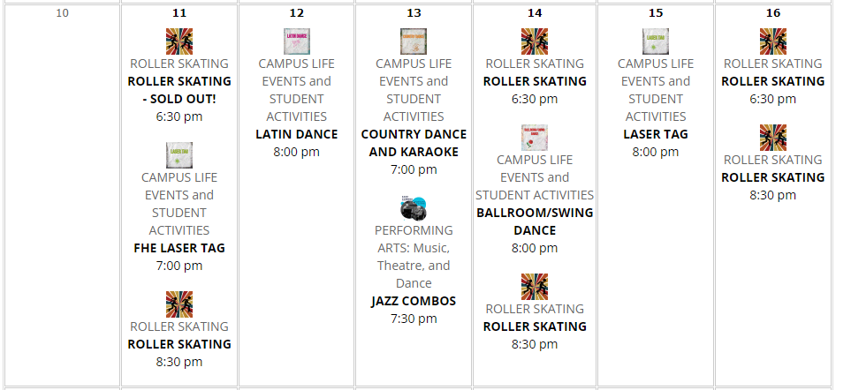
BYU Idaho Activities - March

Slide 29
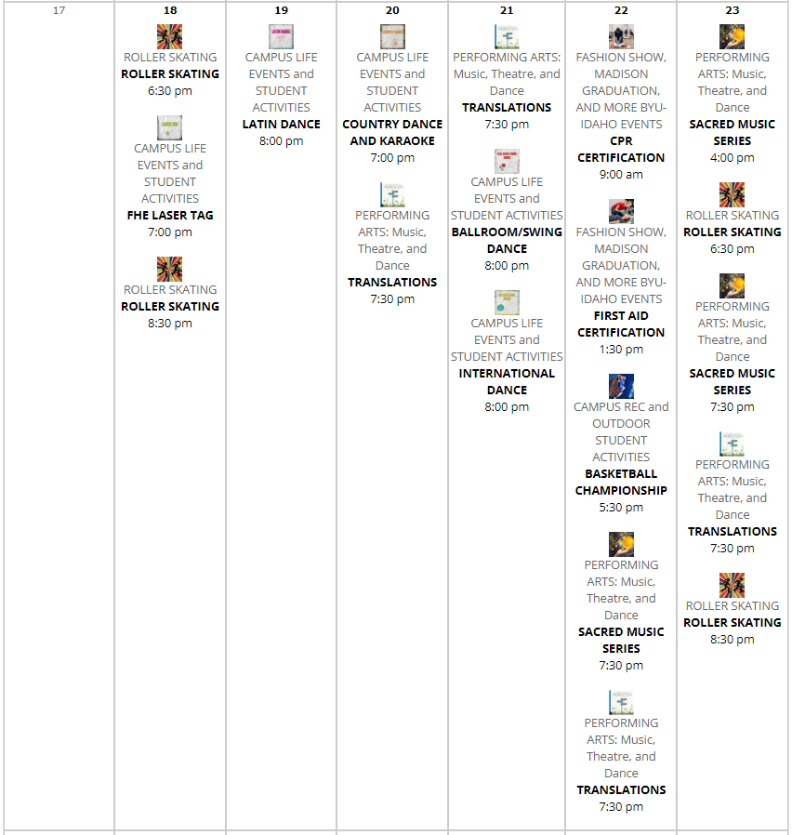
BYU Idaho Activities - March

Slide 30
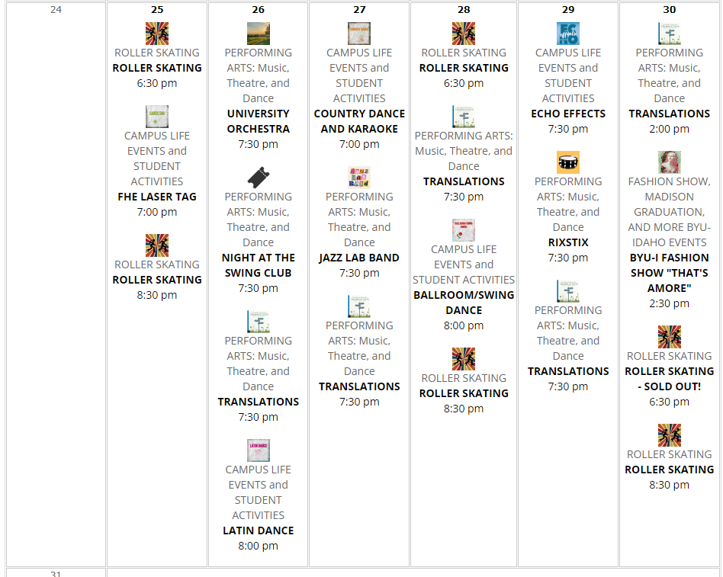
BYU Idaho Activities - March

Slide 31
University Help Resources
Dean of Students Office (byui.edu)
Kimball 290
208-496-9200
BYU-Idaho Counseling Center (byui.edu)
Student Health Center
208-496-9370
After hours – 24/7: 208-496-HELP(4357)
BYU-Idaho Wellness Center (byui.edu)
174 Hart building
208-496-7491
Welcome to the BYU-Idaho Tutoring Center (byui.edu)
2nd floor of the library
208-496-4270
Therapy Assistance Online (TAO): BYU-Idaho Counseling Center (byui.edu)
Online software to help
BYU-Idaho Student Health Center (byui.edu)
Health care and Pharmacy
208-496-9330
Autism Mentoring Program: BYU-Idaho Counseling Center (byui.edu)
Peer Mentoring (byui.edu)
208-496-1441
Many groups and workshops (contact counseling center)
THRIVE: 6 Week Anxiety and Depression Program - BYU Idaho Campus Recreation and Wellness Center Portal

Slide 32
University Help Resources
Student Services
Student Services (byui.edu)
Career services
Career Center (byui.edu)
208-496-9801
MC 200
Alumni Service
Alumni Association | Graduation Office | BYU-Idaho (byui.edu)
208-496-3300
MC 175
Presentation Practice Center:
Presentation Practice Center | Improve Your Public Speaking | BYU-Idaho (byui.edu)
208-496-3719
presentationpractice@byui.edu
IT
IT Services Home (byui.edu)
208-496-1411
Academic Advisor:
Email: CPSEadvising@byui.edu
208-496-9800
https://byu-idaho.screenstepslive.com/s/iplan_help_guides/m/68348/l/1021897-for-students-advising-appointment

Slide 33
University Help Resources
Accessibility Services Office
Mentoring, Student Disabilities, and Accommodations | Student Success | BYU-Idaho (byui.edu)
Career Center:
Career and Academic Advising | BYU-Idaho (byui.edu)
Mentoring, Internships, and Careers
Mentoring, Internships, and Careers (byui.edu)
Mentoring and Student Honors Office:
Mentoring & Student Honor | Student Success Mentoring | BYU-Idaho (byui.edu)

Slide 34
Use of AI - Summary
Generative AI Policy (byui-cse.github.io)
Encouraged to use AI technology to enhance learning, creativity, and productivity
Use to:
Generate or explore new ideas
Solve complex problems
Understand different approaches
Streamline repetitive and time consuming tasks
Code completion and debugging
Code understanding
Innovate solutions
Continuous learning
MUST Site use of AI in code documentation
NEVER USE THE STATEMENT: “I don’t know what this code does, I got it from chatgpt,”
You MUST use AI to help increase your understanding and ability – not to write your code.
You MUST understand what the AI generated code does!!!!
Notes:
.

Slide 35
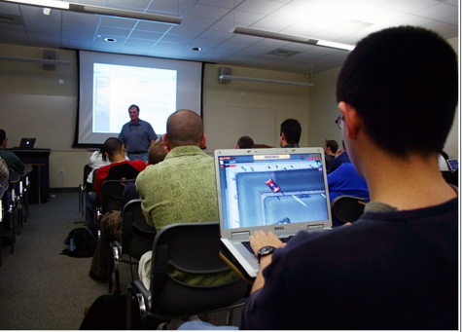
Class Policies
Talking – only one person at a time
Technology – Use for class
No games
No shopping
No videos
Class Roll/Attendance
Know who is here
Use for Grades are end of semester
Expect you to come to class
Contact me
Pass the class?
Attend class and turn in assignments . . .

Slide 36

Homework Policy
Homework – Don’t be Late!!
Turn something in on time
Unlimited re-submittals accepted
Contact me

Slide 37
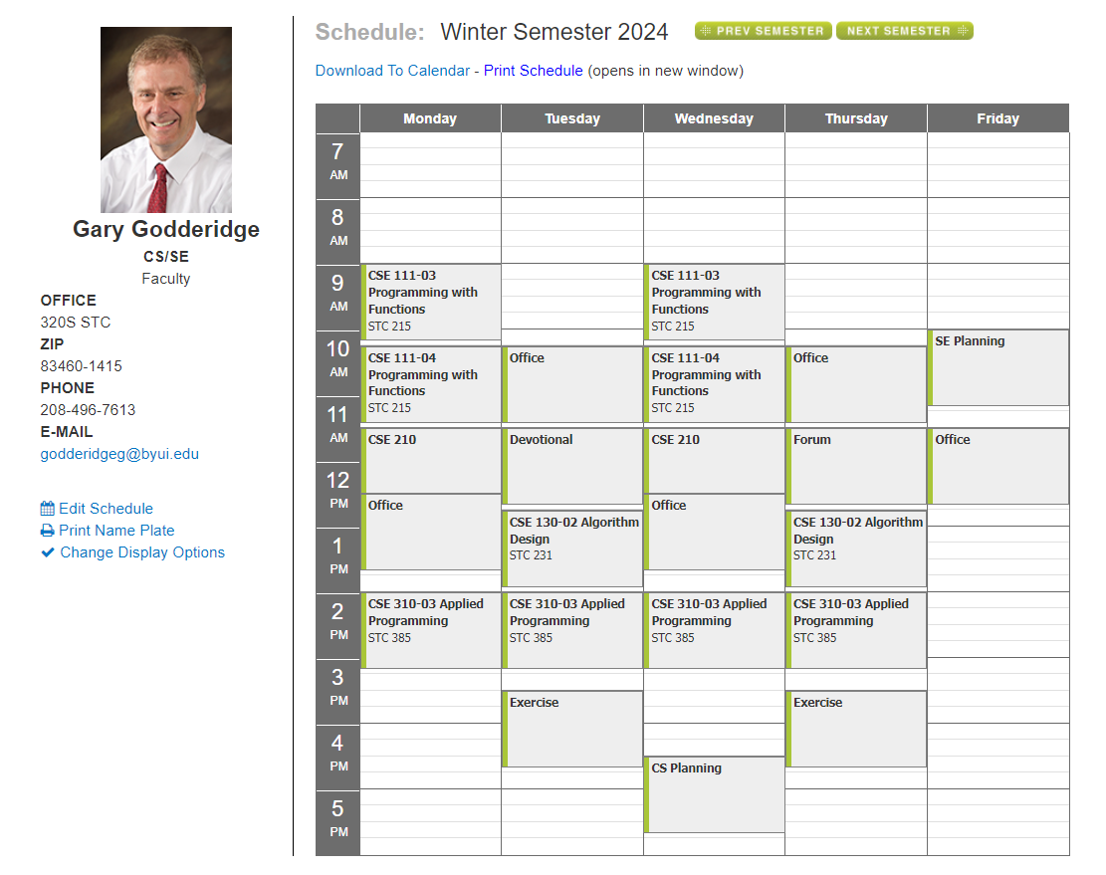

Slide 38

My MS Bookings:
Book time with Godderidge, Gary

Slide 39

Lighten Up
Why did the police arrest the Turkey
They suspected fowl play
What is the Color of the Wind?
Blew
Why did the computer cross the road?
It was programmed by chickens.
Notes:
The computer will run the instructions one at a time – in order. Line upon line.
As in our previous examples, the computer runs our code in order.
Show another example.

Slide 40
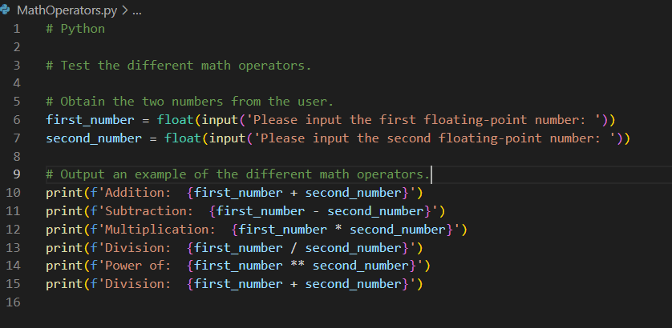
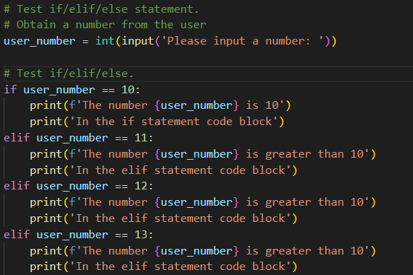
Coding Style/Standard
Variables Names – name it what it is, use underscores to separate words
E.g.,: last_name,
Spaces – use space before and after each operator:
E.g.,: rectangle_area = length * width
Blank Lines
Comments
One comment and one blank line per thought/idea
Code Blocks are indented by 4 spaces

Slide 41

Goals for Today
Homework Assignment Review
Turn in files and links
This week – Program and Movie
Review iLearn
Loops

Slide 42
CSE 130 Course Outline
Week | Topic | Homework
1 | Course Overview | Guessing Game
2 | Python Review | Authentication Program
3 | Flowchart | Monopoly Design
4 | Decisions | Monopoly Program
5 | Pseudocode | Advanced Search Design
6 | Efficiency | Advanced Search Program
7 | Trace | Sort Design
8 | Assert | Sort Program
9 | Collections | Count the Days Design
10 | Loops | Count the Days Program
11 | Review | Review and Practice Final
12 | Maintainability | Prime Design
13 | Course Conclusion/Review | Prime Program
14 | Final Exam

Slide 43
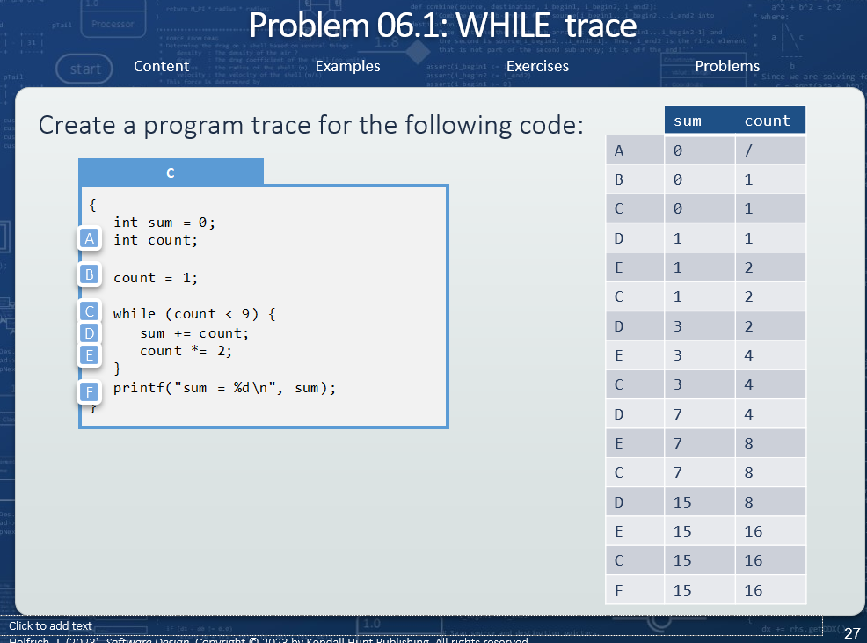
Trace Tables
Design Test Cases – Input and Output
Number/name lines of algorithm
Execute test case to create table
Evaluate results

Slide 44
Review Homework

Slide 45
Review Homework
Count Number Days between two Dates:
Examples
January 9, 2024 to January 20, 2024 -> 11 Days
February 2, 2024 to July 4, 2024 -> 27 + 31 + 30 + 31 + 30 + 4 = 153
From May 17, 1999 to November 10, 2005
14 + 30 + 31 + 31 + 30 + 31 + 30 + 31 + (228)
366 +
365 +
365 +
365 +
366 +
31 + 28 + 31 + 30 + 31 + 30 + 31 + 31 + 30 + 31 + 10 (314)
= 2369
Note – Three cases – same month, same year, across years

Slide 46
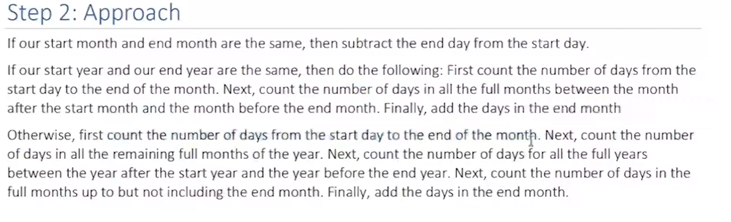
Review Homework

Slide 47
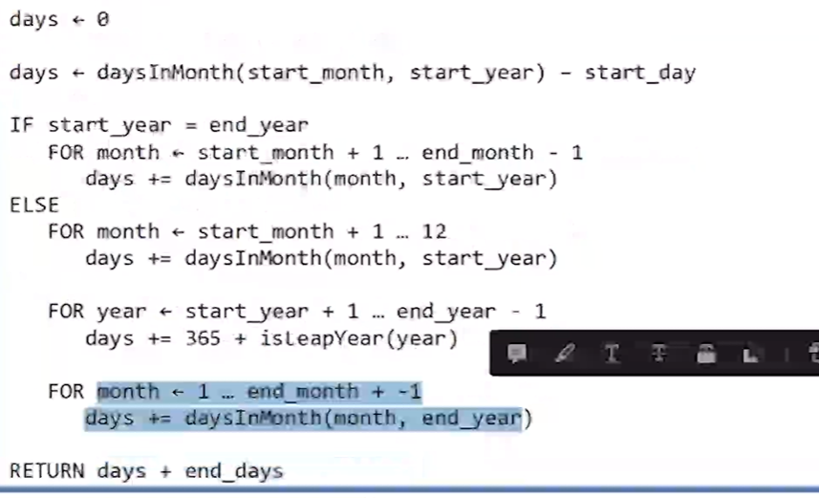
Review Homework

Slide 48
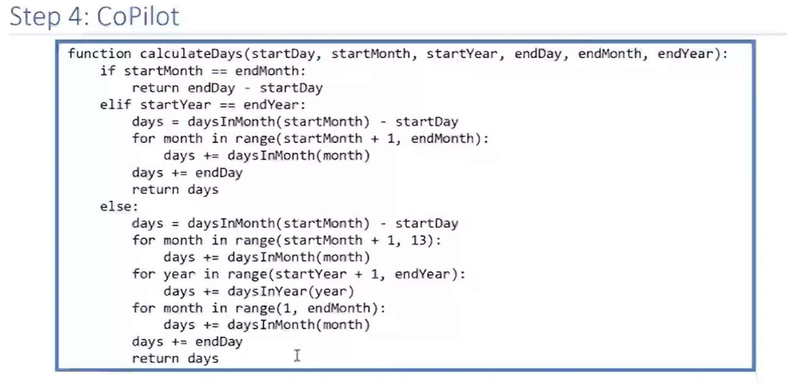
Review Homework

Slide 49
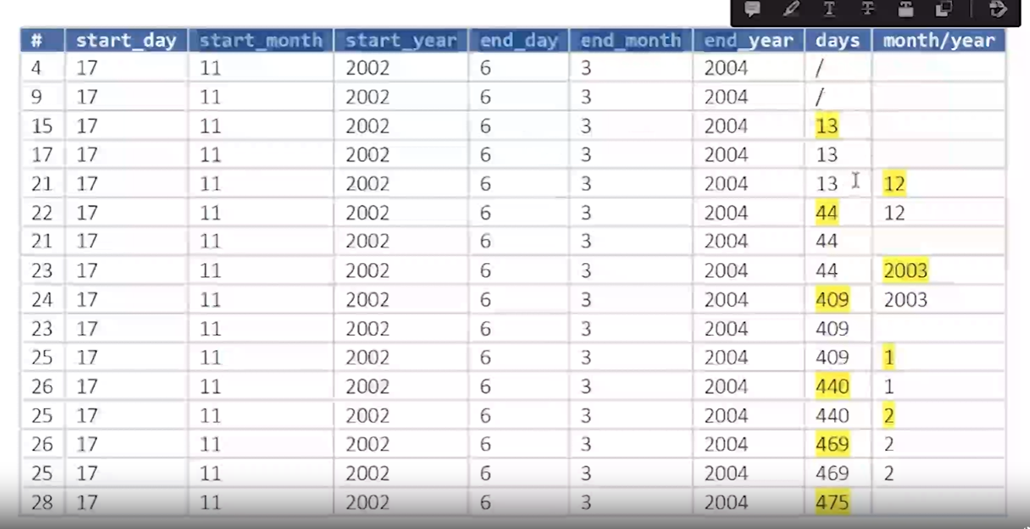
Review Homework

Slide 50
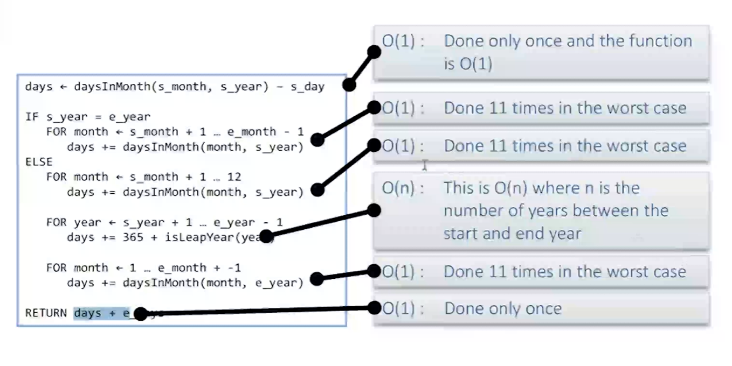
Review Homework

Slide 51
Loops
Event Controlled – until event (user input correct)
Counter Controlled – for number in range(100)
Sentinel Controlled – while not done
Collection Iteration
Index loop – for index in range(length of list)
Pointers – for (*p = text; *p; p++)
Linked Lists – for (p = head; p; p = p->next)
Iterator Loops – for (it = scores.begin(); it != scores.end(); it ++)
Instance Loops – for name in names_list:

Slide 52
Lighten up
What do you say to comfort the Grammar police??
Their, There, They’re – The Ultimate Dad Joke Book
What do you call a square that has been in an accident?
A Wreck-Tangle – ibid
As I shampooed his carpet, an elderly client began to tell me what a wonderful woman his recently deceased wife was.
“Bless her soul, we had 35 happy years together” he said pausing to reminisce.
Looking up he added ‘35 out of 50 ain’t too bad” – Laughter is the best Medicine
The Past, Present, and Future walked into a room.
It was tense . . . – The best joke book ever.
Little Johnny’s new baby brother was screaming up a storm.
Johnny asked his mom – “Where did we get him from?”
“He came from heaven, Johnny” she said.
“Wow! I can see why they threw him out” – Healing through Humor
What happens once ever minute, twice ever moment, but never in a decade?
The letter M– The ultimate Dad Joke Book..
Notes:
IMPORTANT – STOP AND SHOW examples

Slide 53
Lighten up
What does the thesaurus eat for breakfast??
A synonym roll – The Ultimate Dad Joke Book
What is the only word that becomes shorter when you add two letters to it?
Short - ibid
Our waitress’s favorite customers are cops.
“When they’re done”, she says,
“I give them a ticket and they have to pay it before than can leave”?– Laughter is the best Medicine
An Alabama state trooper pulled over a pickup. The trooper asked, “Got any ID?”
The driver replied, “Bout Whut”. – The best joke book ever.
“If Noah had been wise,
He would have swatted those two flies” – Healing through Humor
Golfer: My doctor says I can’t play golf
Caddy: Oh, so he’s played with you, too, huh? – The world’s greatest collection of clean jokes.
Notes:
IMPORTANT – STOP AND SHOW examples

Slide 54
Lighten Up
What’s the difference between a diameter and a radius??
A radius – The Ultimate Dad Joke Book
Why do rocks in space taste a little better than rocks on earth??
They are a little meteor - ibid
The teacher asked: “Johnny, what is the chemical formula for water?”
Johnny replied: “H I J K L M N O!”
The teacher exclaimed – “What are you talking about”
Johnny said: “Yesterday you said it’s H to O” . – The best joke book ever.
A judge looked sternly at two men in his court and asked:
“Can’t this be settled out of court?”
One of the men looked up at the judge and said:
“Your Honor, we were trying to do that when the police came.”– Healing through Humor
A wise school teacher sends home this note to all parents on the first day of school:
“If you promise not to believe everything you child says happens at school,
I’ll promise not to believe everything he or she says happens at home.” – The world’s greatest collection of clean jokes.
“Hello Reverend Smith – This is the IRS. Is Samuel Jones a member of your congregation?”
“He is”
“Did he donate $10,000 to your church?”
“He Will.” – Laughter is the best Medicine
Notes:
IMPORTANT – STOP AND SHOW examples

Slide 55
Floating Point Values – Only an approximation

Slide 56
Lighten Up
How did Scrooge get a football for Christmas?
The ghost of Christmas Passed - The Ultimate Dad Joke Book
Why didn’t the hunter buy a camouflage tent?
He couldn’t find one - ibid
A man was telling his neighbor: “I just bought a new hearing aid. It cost four thousand dollars. But it is state of the art.”
Neighbor: Really, what kind is it.
Man: It’s twelve thirty. – The best joke book ever.
“It’s no good sir”, said the hopeless student to his English teacher. “I try to learn, but everything you say goes in both ears and out the other”.
“Goes in both ears and out the other” ask the puzzled teacher. “But you only have two ears.”
“You see, Sir” I am no good at math either” – Healing through Humor
She says that whenever she is down in the dumps, she gets a new hat.
I have always though that’s where she gets them. – The world’s greatest collection of clean jokes.
What kind of fish do you eat with Peanut Butter?
Jelly Fish – ibid
It’s a bad idea to:
Take a dog named Shark to the beach.
Notes:
IMPORTANT – STOP AND SHOW examples

Slide 57
Lighten Up
What happens when the fog lifts from Los Angeles?
UCLA - The Ultimate Dad Joke Book
Why don’t you ever see elephants hiding in trees?
Because they are so good at it – ibid
What’s the difference between a weird rabbit and an athletic rabbit?
One is a bit funny and the other is a fit bunny – ibid
Why do bees have sticky hair?
They use honey-combs. - ibid
After my speech at a tech conference on “Tips for Going Paperless”, I opened the floor to questions.
“I have one”, said a man, “Where are the handouts?” - Reader’s Digest Laughter is the best medicine
Two snowmen are standing a field and one says to the other:
“Do you smell carrots?”
Notes:
IMPORTANT – STOP AND SHOW examples

Slide 58
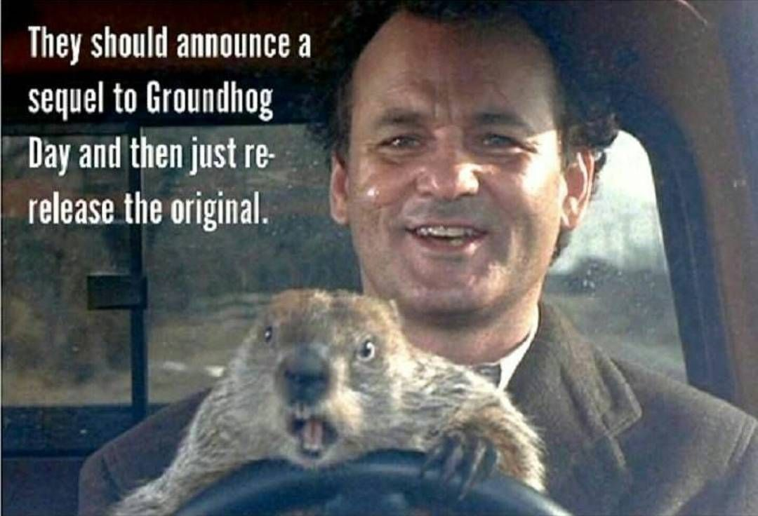
Lighten Up – Groundhog Addition - 20 Funny Groundhog Day Jokes for Kids and Adults (today.com)
Does anyone know any good groundhog day jokes?
I keep hearing the same ones over and over and over again.
What is a groundhog’s favorite drink.
Hole milk
What did the French groundhog see when he woke up?
His Chateau
What is a groundhog’s favorite book?
Holes
What did the groundhog’s trainer tell him before the Olympics?
Gopher gold 20+ Hilarious Groundhog Day Jokes And Puns! | LaffGaff
The majestic Woodchuck, also known as a ground hog, which Begs the question:
How much ground would a ground hog hog if a ground hog could hog ground? The 22+ Best Groundhog Jokes - ↑UPJOKE↑
groundhog dad jokes - Bing images

Slide 59

Lighten Up
What is coming but never arrives?
Tomorrow ☺ - The Ultimate Dad Joke Book
When is a car not a car:
When it turns into the garage - ibid
What should you do if you are being attacked by clowns:
Go for the Juggler - ibid
A job interviewer asked me where I wanted to be in 5 years?
I said, “Ideally, suspended with pay” - Reader’s Digest Laughter is the best medicine
Rob and Tom apply for the same job. They take a written test. “You both got the same number of questions wrong”, the HR person tells them, “but Rob gets the job”.
“If we both got the same number of questions wrong, how come he gets the job?” Tom asked indignantly.
“Well,” says the HR person, “one of his incorrect answers was better than yours.”
“Whoa, how can that be?” Tom asked:
“For problem number 46, Rob wrote ‘I don’t know’, you wrote ‘Me neither.”
Notes:
IMPORTANT – STOP AND SHOW examples

Slide 60
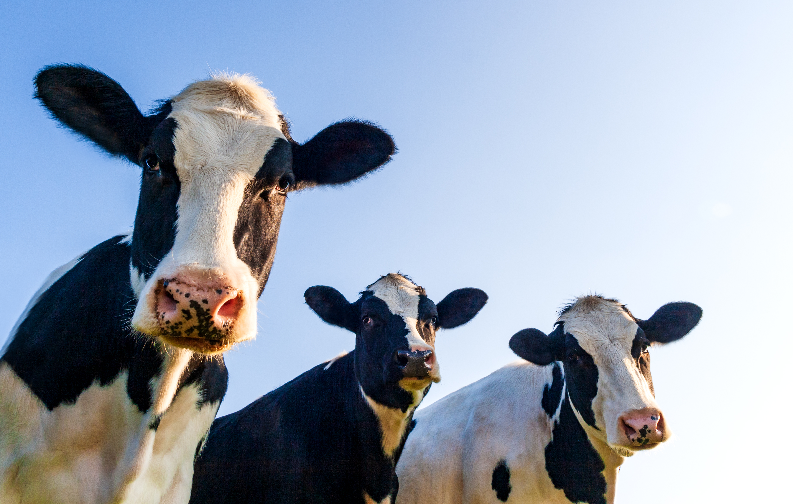
Lighten Up – Cow Edition
Where do cows display their artwork?
At the Moo-seum. – The Ultimate dad Joke Book
What do you call a cow in an earthquake?
A Milkshake. – ibid
What do you call a cow with 3 Legs?
Tri-Tip
What do you call a cow with 2 Legs?
Lean Beef
What do you call a cow with 1 Leg?
Steak
What do you call a cow with no legs?
Ground Beef
What do you call a cow who ran through a fence?
Shredded Beef
What did one cow say to the other?
Got Milk? 50 Cow Jokes That Are Udderly Hilarious | Reader's Digest (rd.com)
What do you call a cow that can’t make milk?
A milk dud – Ibid
What do you call a sad cow?
Moo-dy – Ibid
Notes:
The computer will run the instructions one at a time – in order. Line upon line.
As in our previous examples, the computer runs our code in order.
Show another example.

Slide 61
Lighten Up
Did you know that French Fries weren’t even made in France?
They were fried in Greece. – The Ultimate dad Joke Book
When do you stop at green, but go on red?
When Eating a watermelon – ibid
Buffalo were roaming on the range when a tourist passed by.
“Those are the mangiest-looking beasts I have ever seen” he said
One Buffalo turned to another and said, “I think I just heard a discouraging word” – Laughter really is the best medicine
What do you call a person who crosses the ocean twice without taking a bath?
A dirty double crosser.– The world’s greatest collection of clean jokes.
Someone knocked on my door and asked for a small donation for a local swimming pool.
So I gave them a glass of water. The Best Joke Book Ever.
Interesting Sign at an Electric Company: On a Plumbers Truck:
“We Repair what your husband fixed.”– Healing through humor
Notes:
The computer will run the instructions one at a time – in order. Line upon line.
As in our previous examples, the computer runs our code in order.
Show another example.

Slide 62
Lighten Up
What do you call a fly with no wings?
A walk. – The Ultimate dad Joke Book
Why wouldn’t the tiger eat the clown?
He thought it would taste funny – ibid
You didn’t have to be a brain surgeon to figure out that a customer at our post office was an off-duty mail clerk from another office. He wrote on his package –
“Fragile: Toss Underhand” – Laughter really is the best medicine
Billy was in a store with his mother when he was given a stick of Candy by one of the clerks.
“What do you say, Billy?” prompted his mother.
“Charge it” said Billy– The world’s greatest collection of clean jokes.
Attorney – She had three children – right?
Witness – Yes
Attorney – How many were boys?
Witness – None
Attorney – Were there any Girls?
Witness – Your Honor, I need a different attorney. Can I get a different attorney?. The Best Joke Book Ever.
Interesting Sign at an Optometrist’s Office:
“If you don’t see what you are looking for, you’ve come to the right place.”– Healing through humor
Notes:
The computer will run the instructions one at a time – in order. Line upon line.
As in our previous examples, the computer runs our code in order.
Show another example.

Slide 63
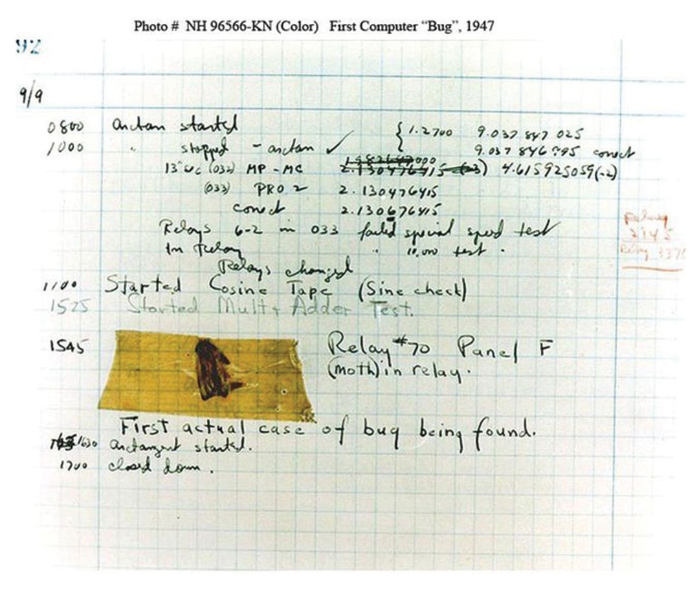
First Software Bug found
September 9, 1947

Slide 64
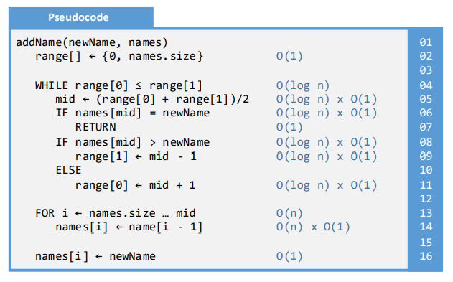
Algorithmic Efficiency Review

Slide 65
Algorithmic Efficiency / Big-O notation
Data set size of 1000
Notation | Name | “Maximum” Iterations to complete algorithm with data set size of 1000
O(1) | Constant | N/A, constant
O(log n) | Logarithmic | 10
O(n) | Linear | 1000
O(n log n) | N-log-N | 10,000
O(n²) | N-Squared | 1,000,000
O(2^{n}) | 2-to-the-N | 2¹⁰⁰⁰ (note: 2⁴⁰ is 1T)

Slide 66
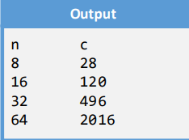
How to Determine Algorithmic Efficiency / Big-O
See Manual Chapter 3
Code Analysis – Review code and make determination
Add Instrumentation
Add counters to algorithm/code
Gather data
Compare Two Rows
Graph Results and Compare to Big-O Graphs
Solve simultaneous equations
Guess level of efficiency (e.g., O (n log n))
Locate associated equation (see chapter 03 of Manual)
Create two equations from data
Set equal to each other – solve. See manual page 78.

Slide 67
Program Asserts
Basic Logic
assert boolean_expression
Assert, or verify, that boolean_expression is True
if boolean_expression is False:
display message
crash/end/exit program
Only used for programming/system errors. NOT used to validate user input.

Slide 68
Spiritual Thought
My plea to you this morning is to find rest from the intensity, uncertainty, and anguish of this world by overcoming the world through your covenants with God. Let Him know through your prayers and your actions that you are serious about overcoming the world. Ask Him to enlighten your mind and send the help you need. Each day, record the thoughts that come to you as you pray; then follow through diligently.
President Russell M. Nelson, “Overcome the World and Find Rest”, October 2022 General Conference
Notes:
How does us coming unto Jesus help us? Help others?

